Slide 1
Sales Performance Analysis of Walmart Stores Using Advanced MySQL Techniques

Slide 2
Introduction
Walmart, a major retail chain, operates across several cities, offering a wide range of products. This project leverages advanced SQL techniques to analyze transaction data and extract meaningful insights on sales performance, customer behavior, and operational efficiencies.

Slide 3
Business Problem
Walmart aims to optimize sales strategies by analyzing historical transaction data across branches, customer types, payment methods, and product lines. Using MySQL queries, we answer key business questions related to sales performance, customer segmentation, and product trends.

Slide 4
Dataset Information
The dataset contains transaction details such as sales figures, customer demographics, payment methods, and product categories etc.

Slide 5
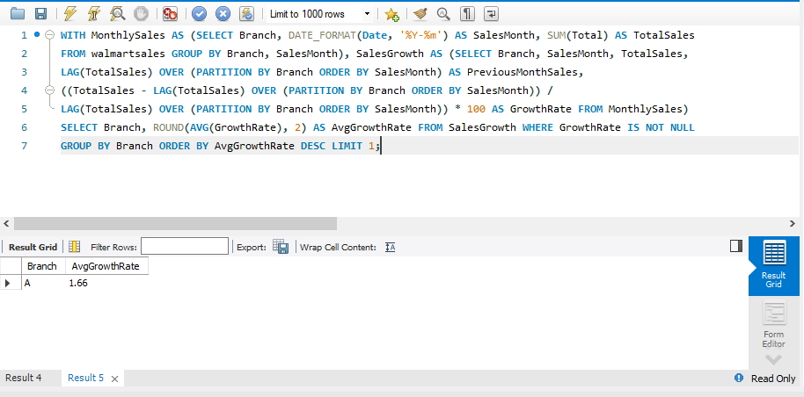
Task 1: Identifying the Top Branch by Sales Growth Rate
Walmart wants to identify which branch has exhibited the highest sales growth over time.

Slide 6
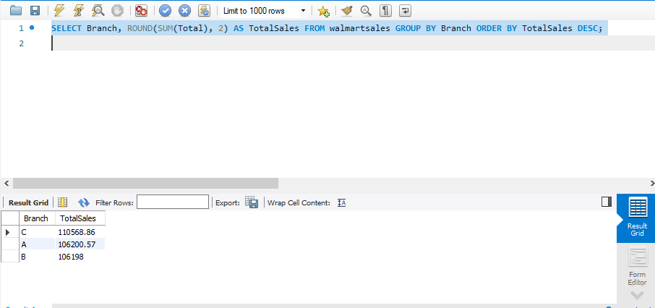
Total sales for each brunch is:

Slide 7
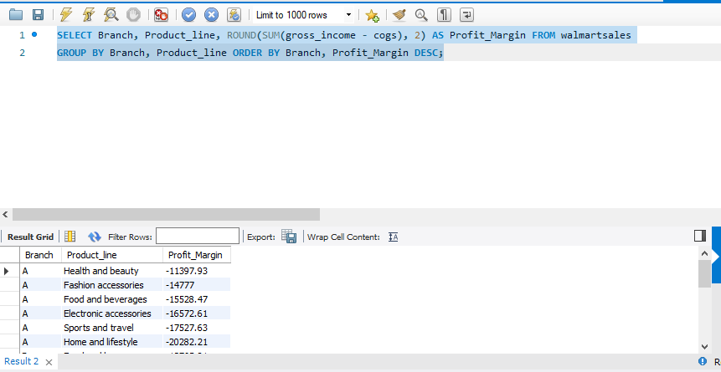
Task 2: Finding the Most Profitable Product Line for Each Branch
Walmart needs to determine which product line contributes the highest profit to each branch. The profit margin should be calculated based on the difference between the gross income and cost of goods sold.

Slide 8
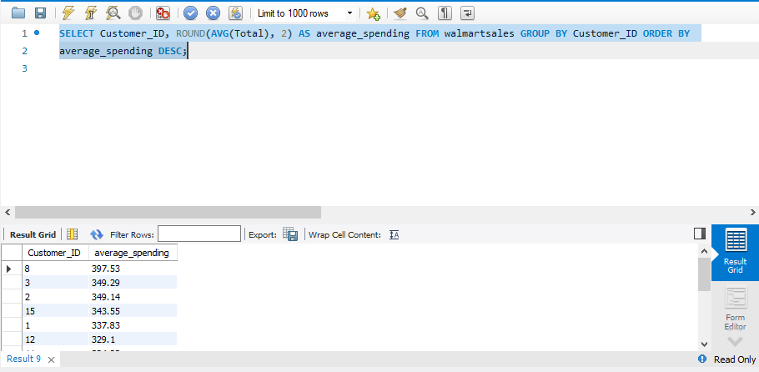
Task 3: Analyzing Customer Segmentation Based on Spending
Walmart wants to segment customers based on their average spending behavior.

Slide 9
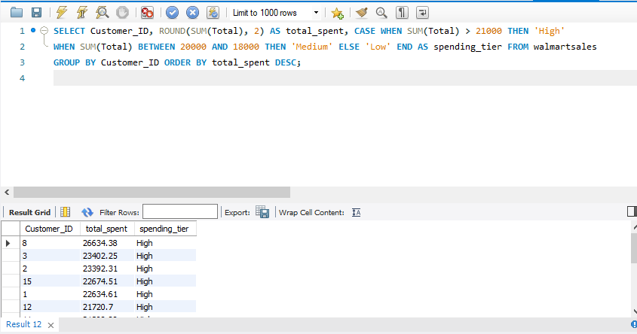
Classify customers into three tiers: High, Medium, and Low spenders based on their total purchase amounts.

Slide 10
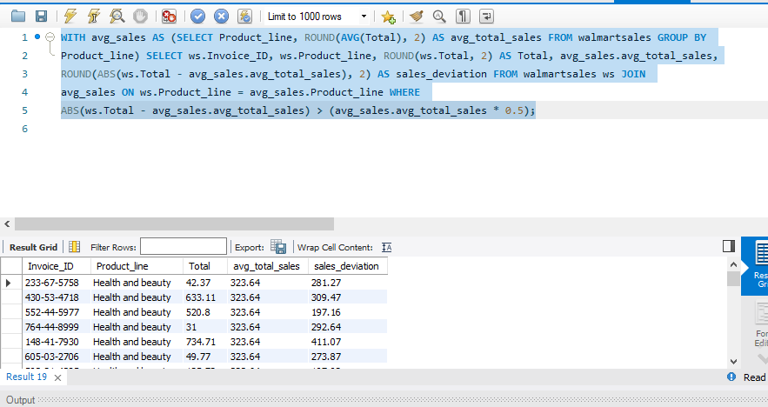
Task 4: Detecting Anomalies in Sales Transactions
Walmart suspects that some transactions have unusually high or low sales compared to the average for the product line. Identify these anomalies.

Slide 11

Task 5: Most Popular Payment Method by City
Walmart needs to determine the most popular payment method in each city to tailor marketing strategies.

Slide 12
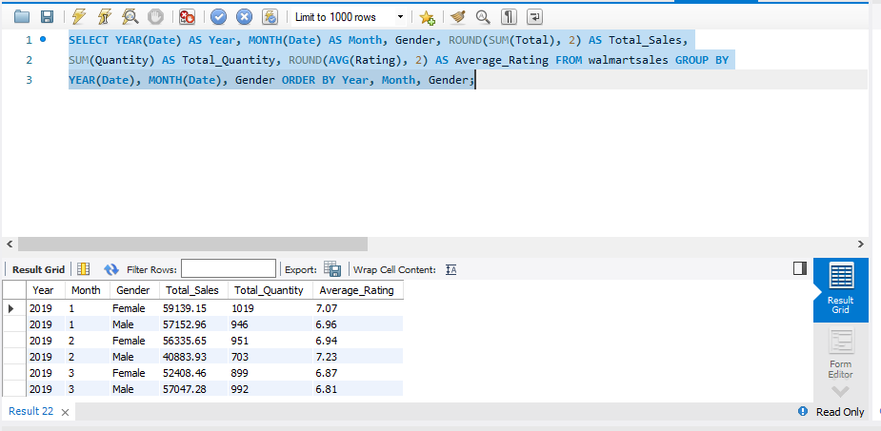
Task 6: Monthly Sales Distribution by Gender
Walmart wants to understand the sales distribution between male and female customers on a monthly basis.

Slide 13
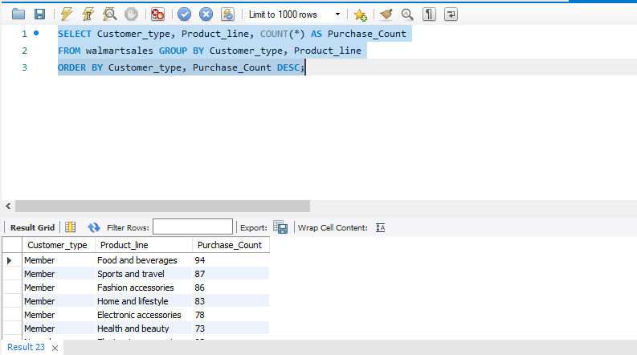
Task 7: Best Product Line by Customer Type
Walmart wants to know which product lines are preferred by different customer types(Member vs. Normal).

Slide 14
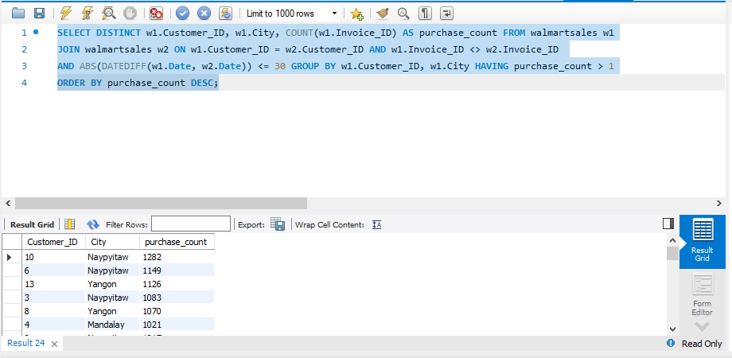
Task 8: Identifying Repeat Customers
Walmart needs to identify customers who made repeat purchases within a specific time frame (e.g., within 30 days).

Slide 15
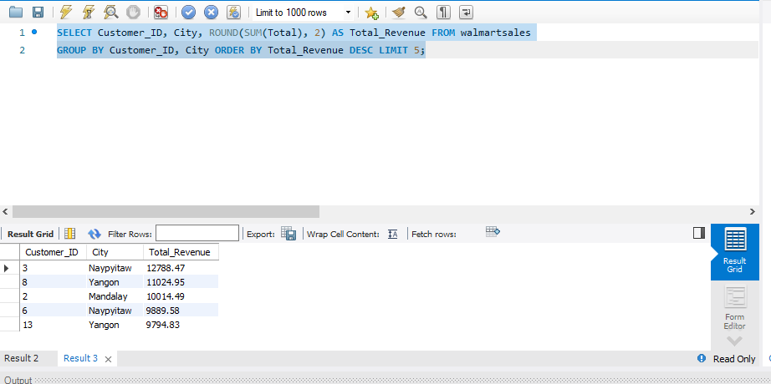
Task 9: Finding Top 5 Customers by Sales Volume
Walmart wants to reward its top 5 customers who have generated the most sales Revenue.

Slide 16
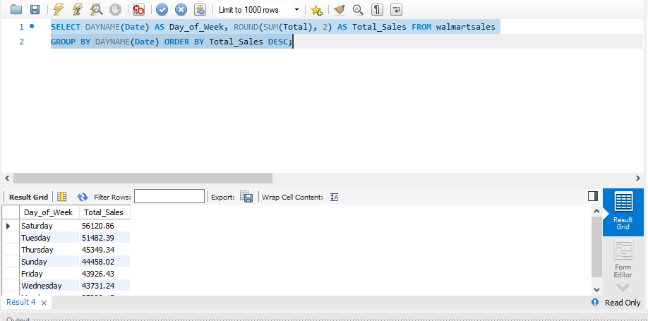
Task 10: Analyzing Sales Trends by Day of the Week
Walmart wants to analyze the sales patterns to determine which day of the week brings the highest sales.

Slide 17
Conclusion
This analysis provided actionable insights into Walmart's sales performance. The findings can help optimize strategies for increased profitability and customer satisfaction.

